Slide 1
Computer Lab 4:
Data Preparation
SOST20022 Essentials of survey design and analysis 2024-25

Slide 2
Content
General steps of data preparation
Errors, missing values, outliers
Q & A of R Basics/Essay ideas

Slide 3
General steps for data analysis
1) setting directory/notes/packages/read data
2) browse the data
3) data cleaning (incorrect responses, outliers, missing data)
4) data wrangling (meaningful and accessible→ recoding)
5) descriptive analysis (table, figure)
6) hypothesis testing

Slide 4
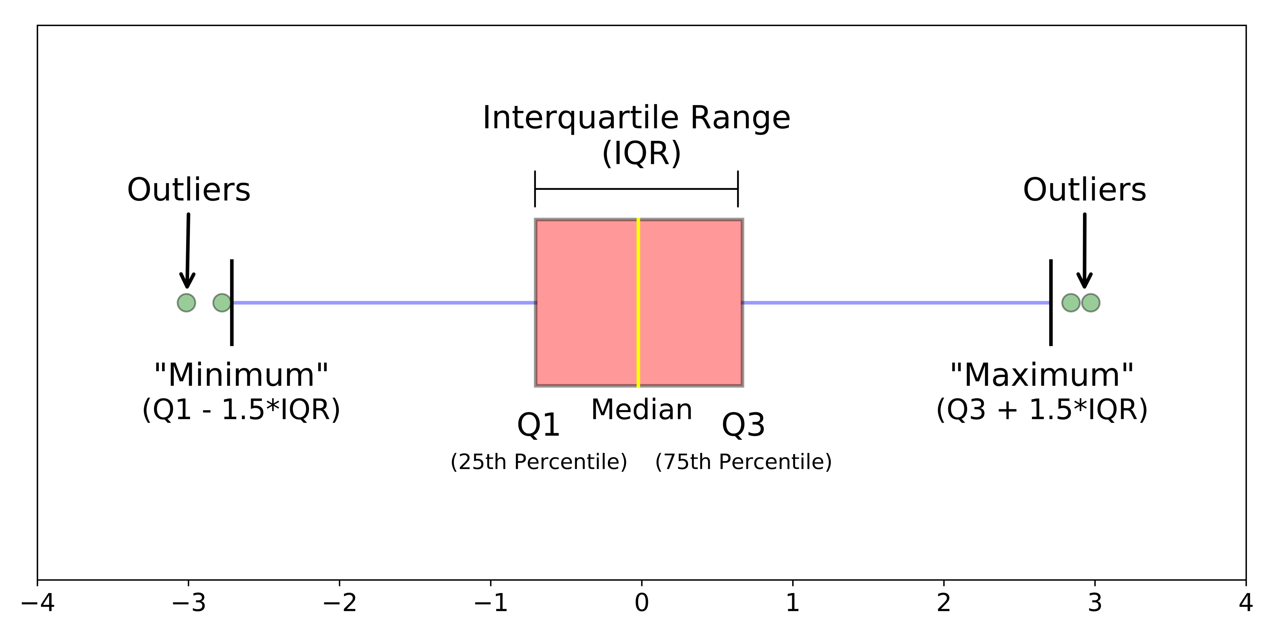
Errors, Missing Values, Outliers,
Measurement Error/ Processing error
  Initial check (descriptive analysis): logic check, distribution
    Continuous variable: histogram/ summary statistics (mean, range, s.d.)
    Categorical variable: bar chart/ table
  Treat it as missing
Missing values:
  Ignore
  Weighting
  Imputation
Outliers
  Visualisation: boxplot, histogram
  IQR Methods
  Logic check (valid range; subjectivity)
  How to deal with them:
    Don’t do anything
    trimming, capping

Slide 5
Useful codes for data preparation
Browse the data (initial check)
  Categorical: table(data$var); barplot(table(data$var))
  Continuous: summary(data$var); mean(); sd(); quantile(); hist(data$var); boxplot(data$var)
Data cleaning (missing data; outliers)
  is.na()
  data[data==-9] <- NA
  data[data<lower_bound|data>upper_bound] <- NA
Data wrangling (record for specific analysis)
  Overwrite/Creating new variables
Presenting distribution
  write.table(); dev.off

Slide 6
More Q&A…

